Slide 1
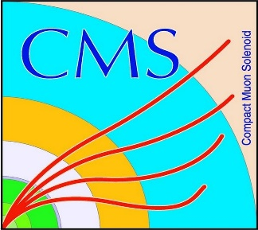

HEP Weekly Report
George Bakas
NTUA

Slide 2
Progress Report
ArdEnvino
Start the Fusion360 tutorial
Analysis
Generate a ttbar MC without spin correlation
Already contacted the conveners of the Top Properties Subgroup
Try and reconstruct the sensitive observables at reco level

